Slide 1
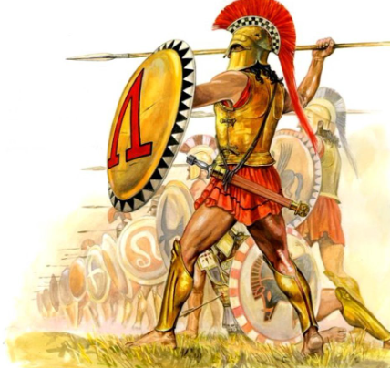
Spartan S-3 Training Dashboard
Fitness Tests
CFT:
Location: Paige Field House
Date/Time: Thursdays at 0630
Addition dates and times by request.
Current PHA Required (bring IMR)
PFT:
By request. Schedule with S-3.
Height and Weight
All Semi-Annual height and weights are conducted by a member of the S3
Times: 0800-1530
Female CPTR will be provided Monday, Wednesday, Friday
OMPF Photo verification upon request
Upcoming Training/Courses
24 Aug 2023: SAPR Training; 0800-1200 (Postal Classroom)
25 Aug 2023: UMAPIT; 1000-1100 (Postal Classroom)
11-29 Sep 2023: HQSPTBN MAI Course; (24) quotas. Contact your company office if interested.
FFI Course 01 Oct – 16 Nov 2023; (2) quotas. Contact your company office.
MTU
ARQ 33-23 (30 quotas)
  Grass Week: 7-11 Aug 2023
  Firing Week: 14-16 Aug 2023
PD 18-23 (10 quotas)
  Grass Week: 8-11 Aug 2023
  Firing Week: 14-16 Aug 2023
ARQ 34-23 (30 quotas)
  Grass Week: 14-18 Aug 2023
  Firing Week: 21-23 Aug 2023
ARQ 35-23 (30 quotas)
  Grass Week: 21-25 Aug2023
  Firing Week: 28-30 Aug 2023
PD 19-23 (10 quotas)
  Grass Week: 22-25 Aug 2023
  Firing Week: 28-30 Aug 2023
24 Aug 2023: HQSPTBN Pistol Qualification (R213).
General Information
S-3 Hours:
  0730 – 1530 M – Th
  0730 – 1100 Fr
  1100 – COB Fr (Internal Admin/Training)
Plan of the Week distributed every Friday. Covers 2-weeks out.
HQSPTBN calendar located on outlook. Contact S-3 for access or search HQSPTBN Calendar in shared calendars.
S-3 Points of Contact:
Operations Officer: Major Brian A. Hinrichs; brian.hinrichs@usmc.mil; 760-763-2041
Operations Chief: GySgt Antwan D. Ansley; antwan.ansley@usmc.mil; 760-725-5050
Training Chief: GySgt Ryan A. Vollemaere; ryan.vollemaere@usmc.mil; 760-725-6088
MTU Chief: SSgt Rony A. Lopezllanes; rony.lopezllanes@usmc.mil; 760-763-7952

